Slide 1
Outdoor Ethics Guide

Slide 2
Welcome
Menti

Slide 3
The Land Ethic
The land ethic is a change in how we relate to the land. It helps us to move from a position of conqueror and user of the land to a member and citizen of the land. It implies that the land has a right to be respected and continue to exist. “The land ethic simply enlarges the boundaries of the community to include soils, waters, plants, and animals, or collectively: the land.”
The first step to embracing outdoor ethics is to recognize that outdoor activities cause an impact to the land, water, natural resources, animals, and people.

Slide 4
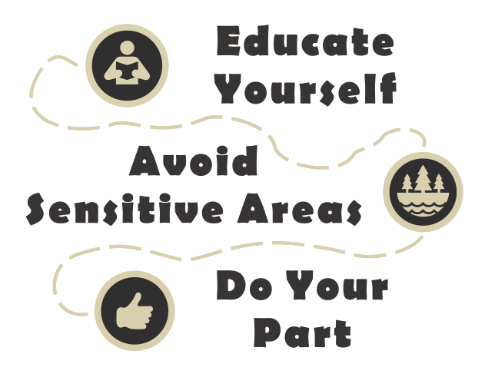
TREAD Lightly!
Promoting responsible recreation through stewardship, education and communication.

Slide 5
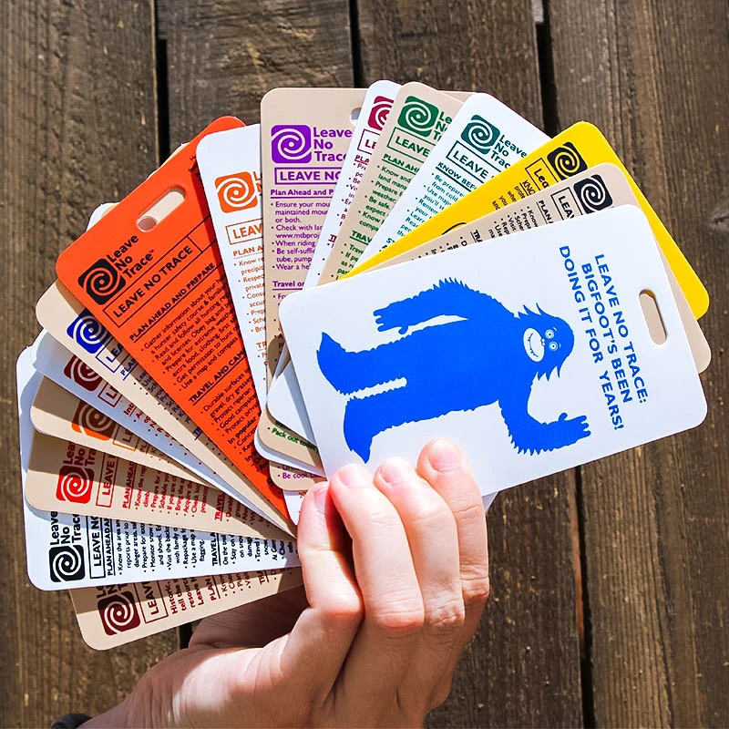
Leave No Trace
While we enjoy the natural world, Leave No Trace teaches us how to minimize our impacts.

Slide 6
Outdoor Ethics
THE PURPOSE OF THIS HANDBOOK IS TO GUIDE UNITS IN DEVELOPING A CULTURE THAT EFFECTIVELY DEMONSTRATES RESPONSIBLE OUTDOOR CHOICES THAT REDUCE IMPACTS OF SCOUTING ACTIVITIES.
ON BREAKING UP CAMP LEAVE TWO THINGS BEHIND YOU: 1—NOTHING. 2—YOUR THANKS.
—LORD BADEN-POWELL, OCTOBER 1919

Slide 7
The Outdoor Ethics Guide
As the outdoor ethics guide, you serve as a member of the patrol leaders’ council representing outdoor ethics. To be successful, you need to understand the needs of your troop as well as the needs of the Scouts.
The person chosen as outdoor ethics guide must be willing to take on the additional time and responsibility of being an outdoor ethics guide. You will be the primary role model on how to behave in the outdoors. You must agree and willingly execute your roles and responsibilities. If questions or problems come up, you must be willing to go to the appropriate leadership for guidance and resolution.

Slide 8
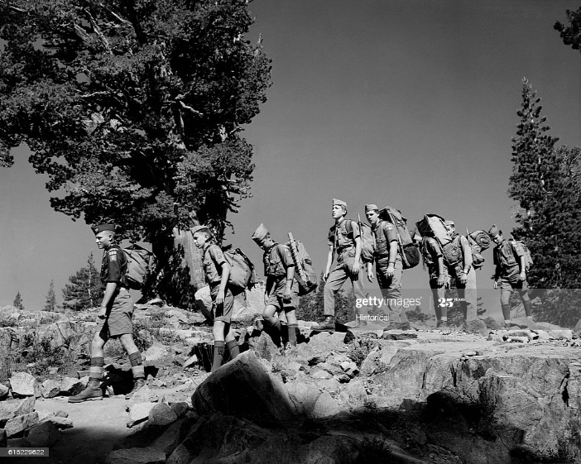
YOUR ROLE
The role of the outdoor ethics guide gives you a unique opportunity to help others make choices that reduce impacts to our natural environment. This includes reducing impacts made by our passing as well as actions that impact the experience of others. The challenge for all of us is to:
Minimize what impacts you can.
Avoid those you cannot.
Preserve the quality of outdoor resources and recreational experience!

Slide 9
1. Explain and Demonstrate Advancement Requirements
Demonstrate Principles
• Before a campout or outing, make a plan for working with Scouts and discuss it with them.
• Go through the steps of planning a patrol activity and identify situations that are addressed in the
principles of Leave No Trace or Tread Lightly!.
• Practice teaching these using the EDGE method.
• Make sure you bring any supplies or equipment you need to teach these skills.
• Set up stations or scenarios for Scouts to demonstrate their new skills to you.
• Idea: Use your unit duty roster or a similar tool to help others understand how principles relate
to duties.

Slide 10
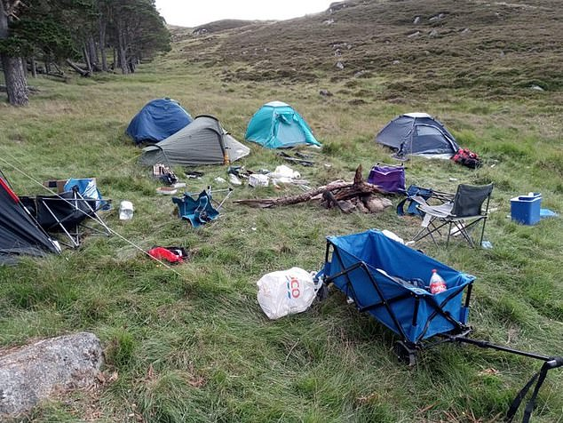
2. Help Your Unit Plan and Conduct an Effective Outdoor Ethics Program
Lead activities, games, and challenges to help your unit learn to practice outdoor ethics.
Once members understand how to practice outdoor ethics, develop a plan with patrol leaders or the senior patrol leader to recognize and reduce impacts of your upcoming activity
Camp Oh No!

Slide 11
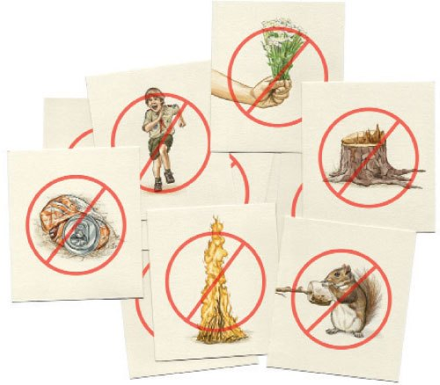
3. Prepare Den Chiefs to Share Principles
• Explain to den chiefs that outdoor activity leaves impacts.
• Identify appropriate activities and games about these impacts.
• Be sure you can explain the activities and games, keep directions short, and make it fun!
• Share appropriate activities and games about outdoor ethics with the den chief.
• Be available to assist the den chief.

Slide 12
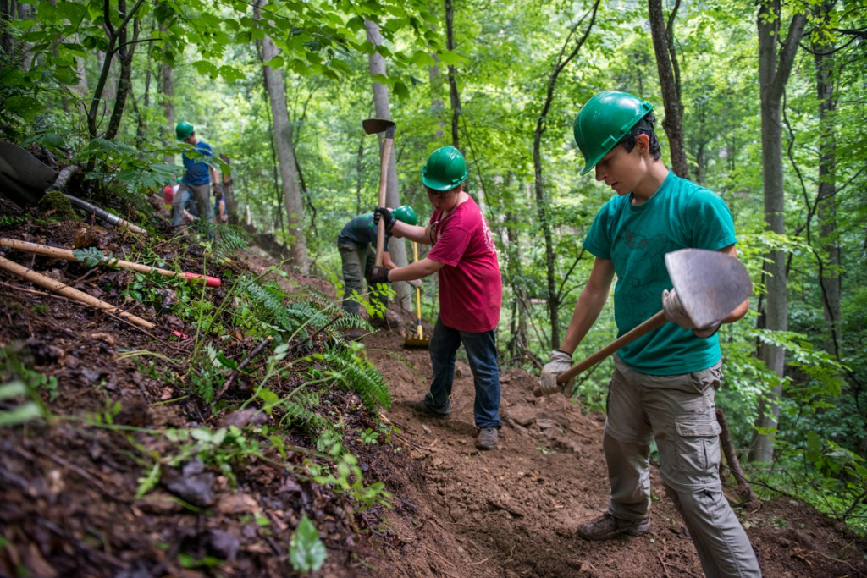
4. Help Scouts to Understand and Plan Conservation Activities
Conservation is one of the foundations of the Scouting program. This means taking care of the outdoors so animals, plants, and people all have healthy habitats in which to live.

Slide 13
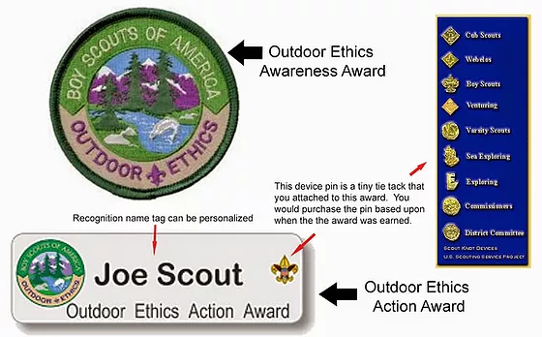
5. Encourage Scouts to Complete Outdoor Ethics Awards and Merit Badges 6. Complete Self-Evaluation (pg 15 in your guide book)
Outdoor Ethics Awareness and Outdoor Ethics Action awards.
Environmental and Nature Merit Badges
Outdoor Awards
Distinguished Conservation Service Award (formerly Hornaday Award)

Slide 14
resources for scouting
http://outdoorethics-bsa.org/
https://www.scouting.org/outdoor-programs/
https://lnt.org/

Slide 15
The Outdoor Ethics Guide Advisor’s Role
Functions of the Advisor
A strong outdoor ethics presence in Scouting was intentionally embedded into our outdoor experiences because we needed it. Your role is to help the outdoor ethics guide answer questions on how Scouts actually practice the Outdoor Code.
For the outdoor ethics guide to be successful, adult leaders must realize the need to update outdoor practices and support methods to reduce impacts.
As the outdoor ethics guide advisor, you may have the opportunity to open doors for the outdoor ethics guide. He or she may need to contact Leave No Trace trainers or Master Educators for ideas and activities. They may want to work with a Cub Scout pack and need to know whom to contact and how. Your role includes opening doors like this to help the outdoor ethics guide be successful.

Slide 16
5 minute break

Slide 17
THE TEACHING EDGE METHOD (p16 in your book)
Teaching Outdoor Ethics With the EDGE Method:
A Sample Format
Use the EDGE method as described in the Scout Handbook. As part of your planning, decide how you
will Explain, Demonstrate, Guide, and Enable the Scout to be successful.
Explain outdoor ethics: This can occur at a meeting or outing. Use your Scout Handbook to discuss the rank-appropriate information: Outdoor Code, principles of Leave No Trace, and Tread Lightly! principles.
Demonstrate: This can be done as part of planning a campout or outing at a patrol meeting.
Select specific principles and show what one might do to practice them. Use materials from
Teaching Leave No Trace or from the resource section of this handbook, or make up a game
or activity. Show how outdoor ethics, including the Outdoor Code, Leave No Trace, and Tread
Lightly!, fit into the outdoor program.
Guide: Guide Scouts in practicing outdoor ethics at a campout or outing. Assist Scouts in making
choices that demonstrate the Leave No Trace or Tread Lightly! principles.
Enable: Provide opportunities for Scouts to demonstrate outdoor ethics at a campout or outing.
Give feedback as to the effectiveness of their actions and any improvement that is needed.
When finished teaching, remember to evaluate. Meet with Scouts to review how outdoor ethics was
practiced on a campout or outing. When requirements have been met, sign off outdoor ethics-related
advancement records.
Kahoot

Slide 18
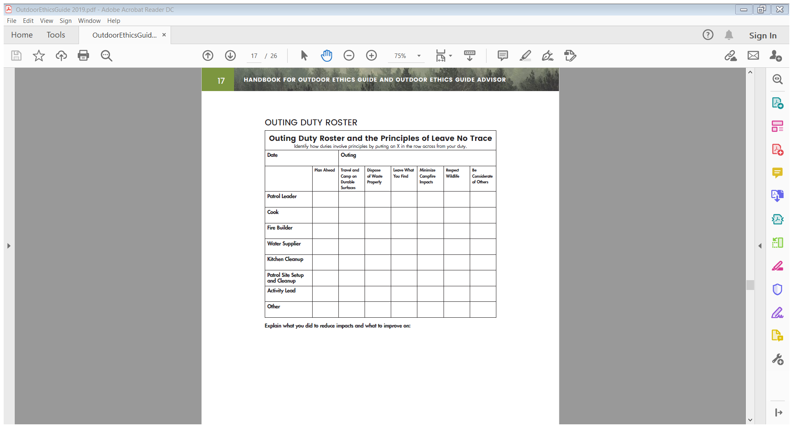

Slide 19
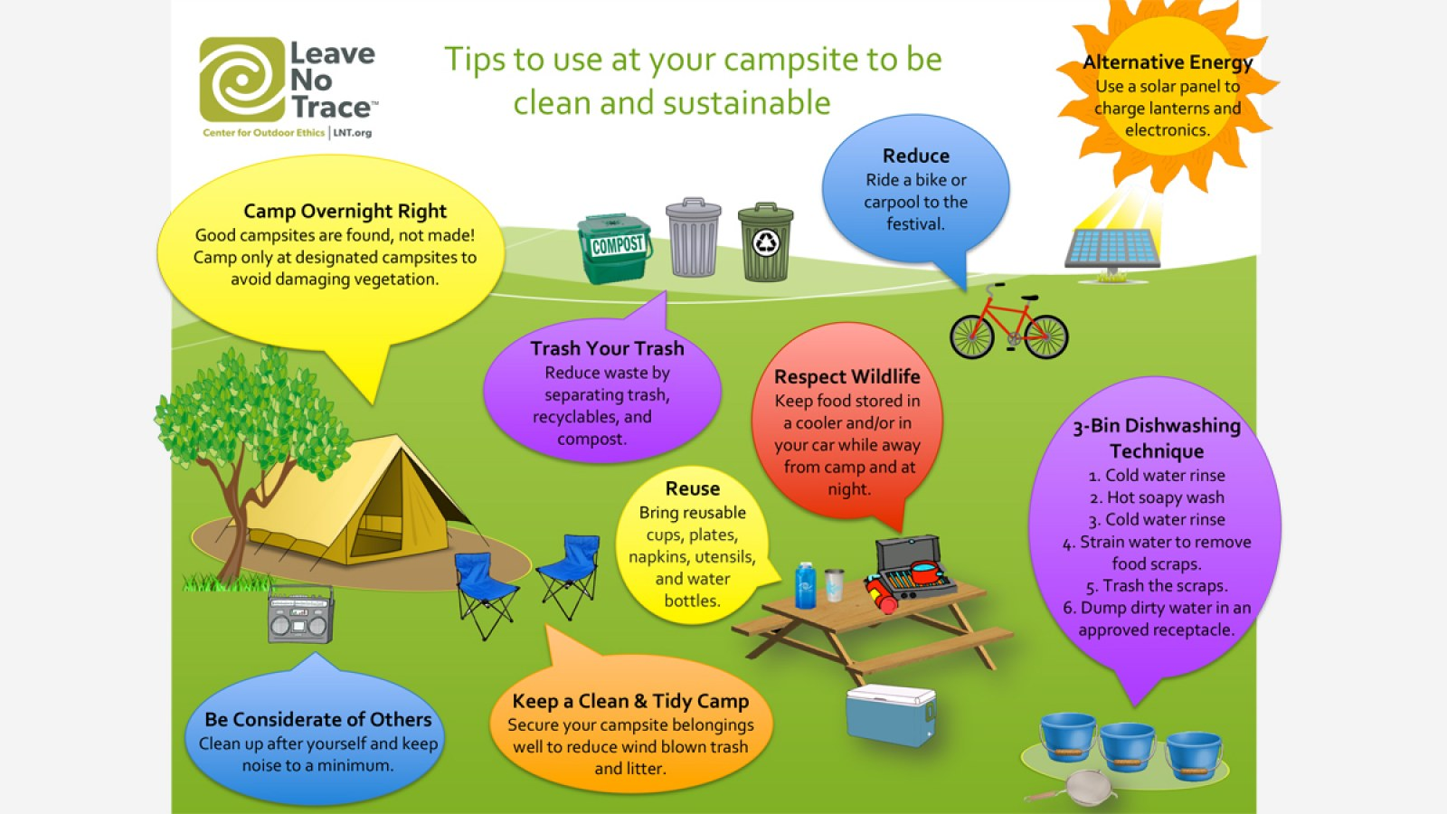

Slide 20
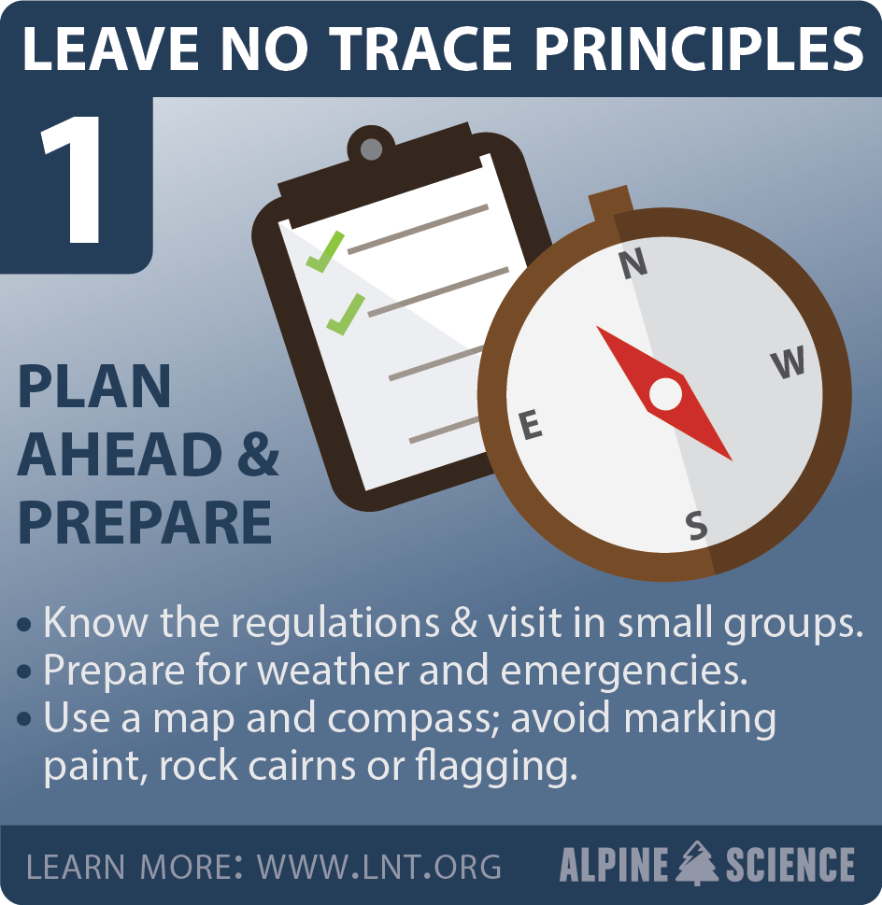
How Prepared Are You?
Peak Activity

Slide 21
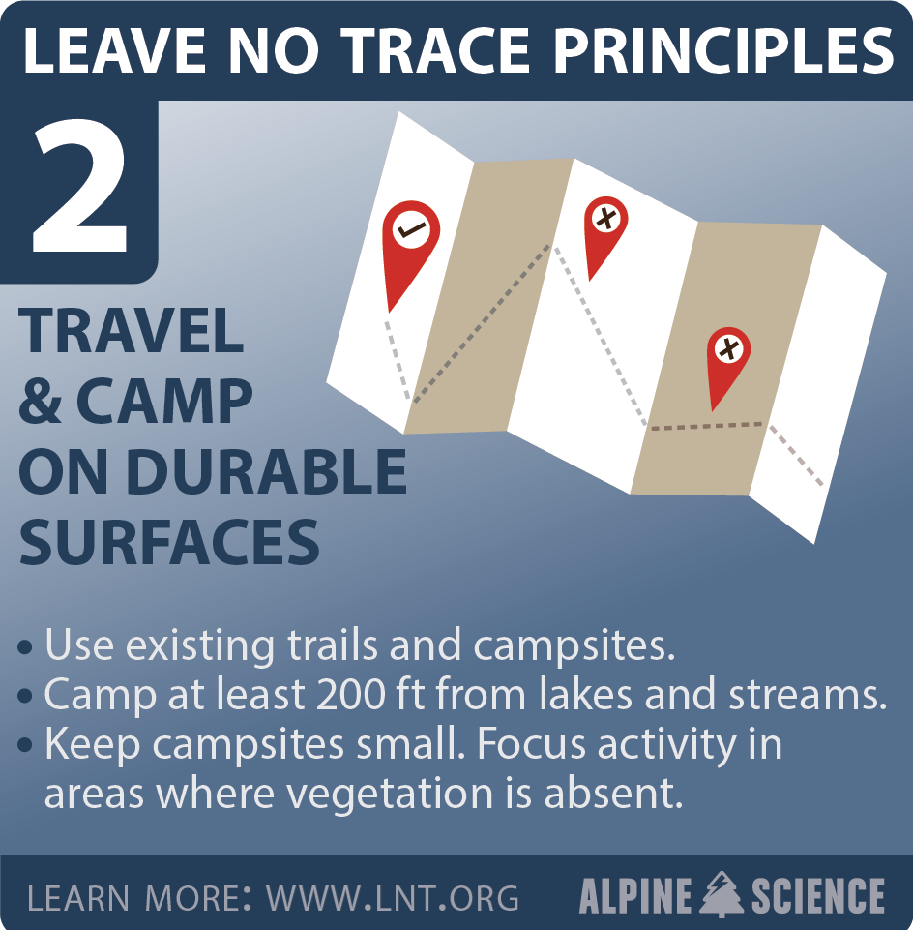
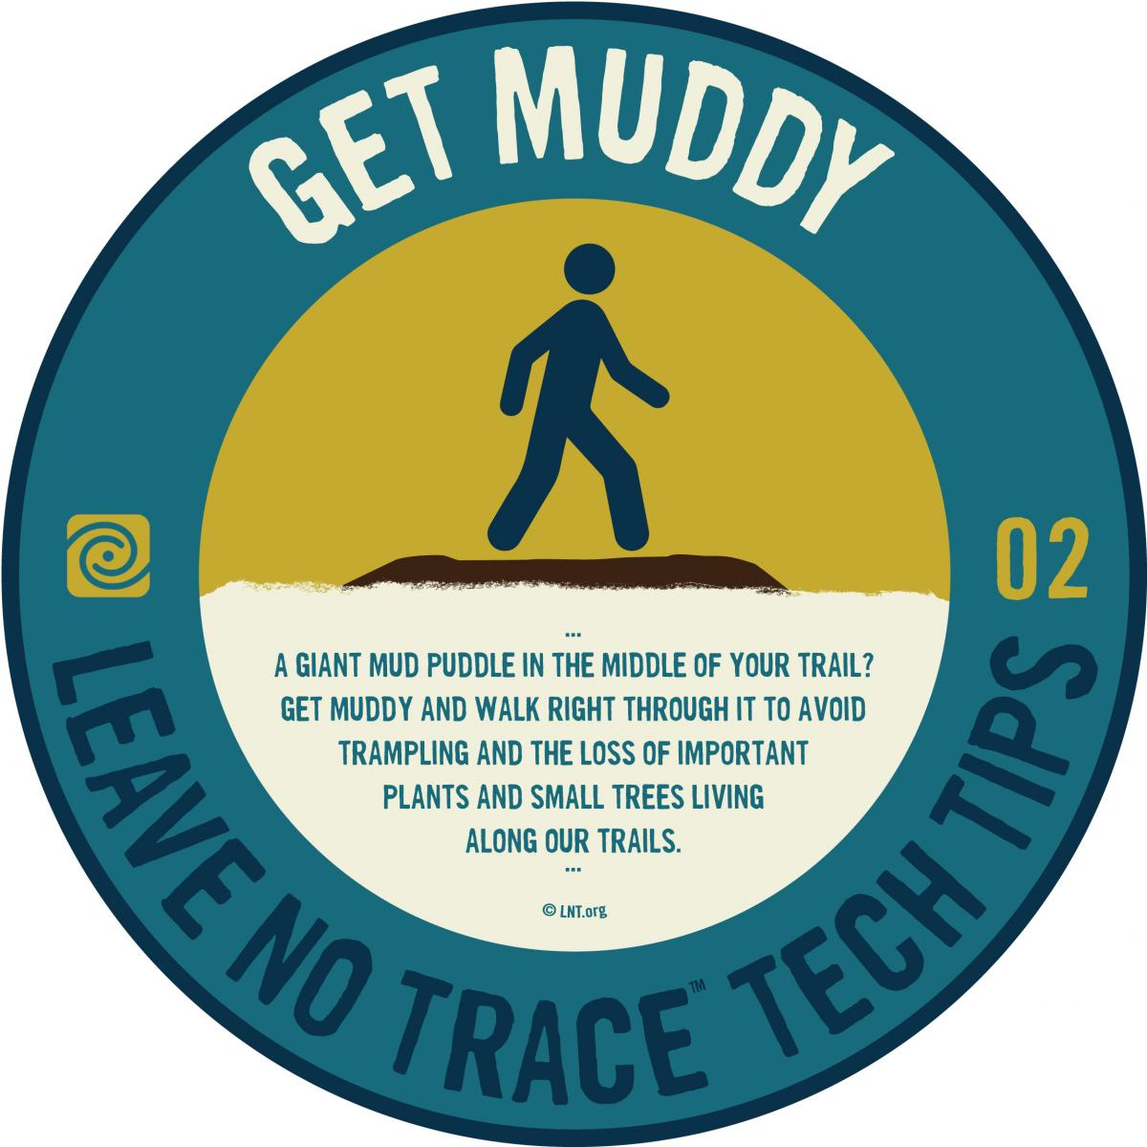

Slide 22
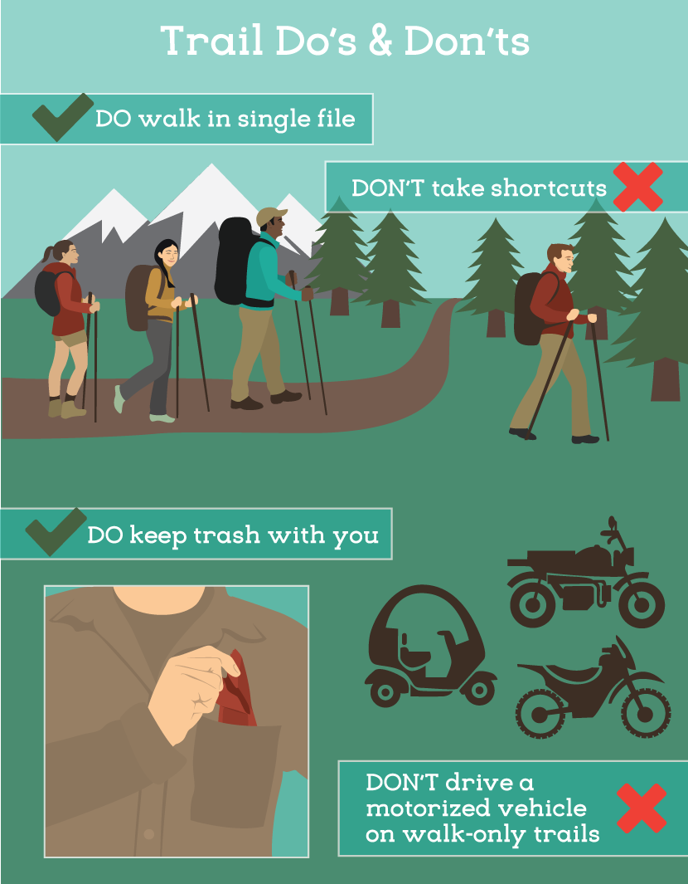

Slide 24
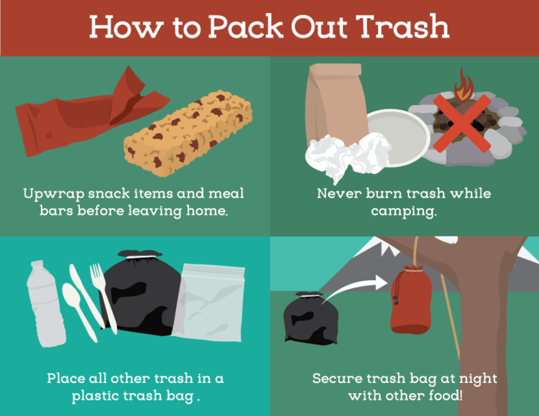

Slide 25
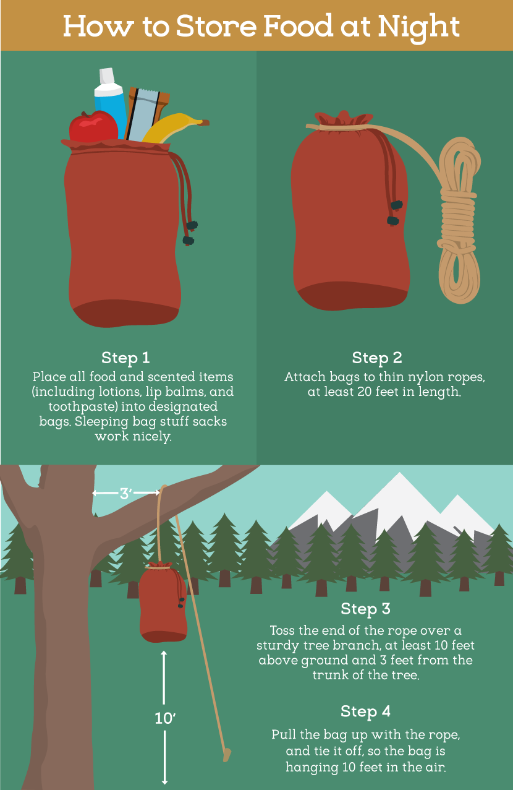

Slide 26
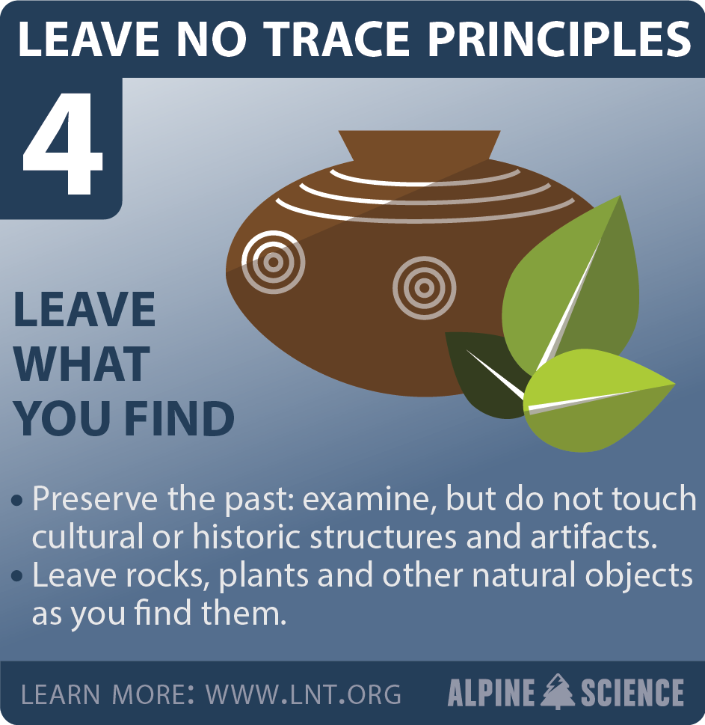
Ethics Game

Slide 28
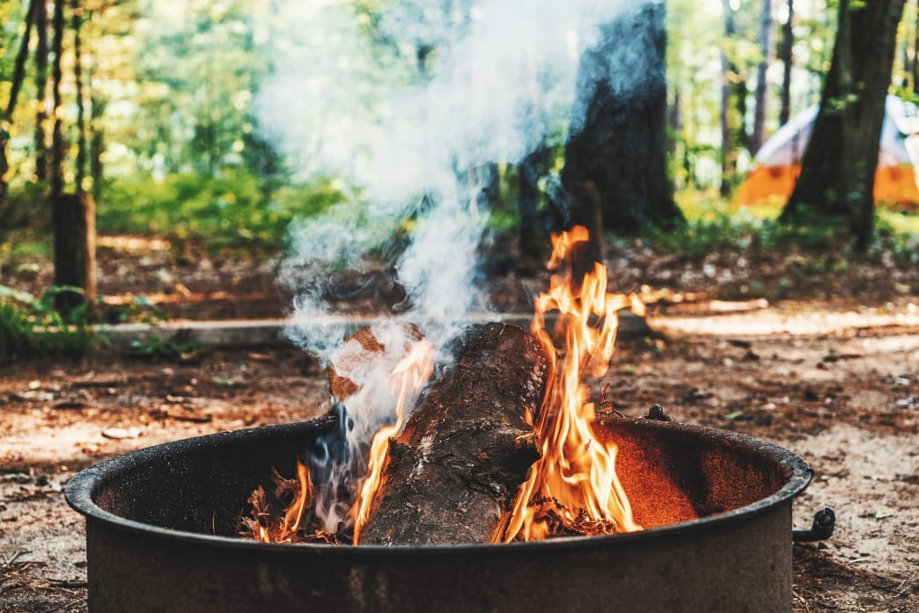
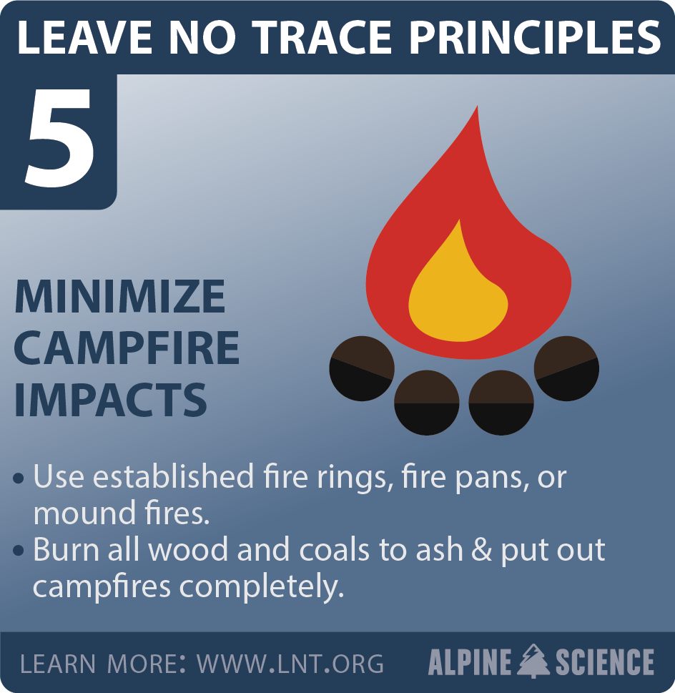

Slide 29
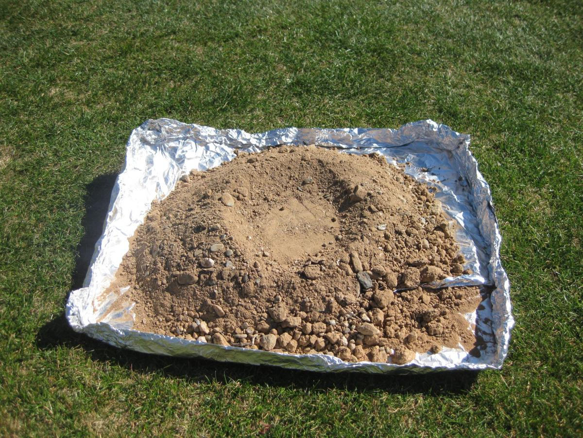
Mound Fires

Slide 30
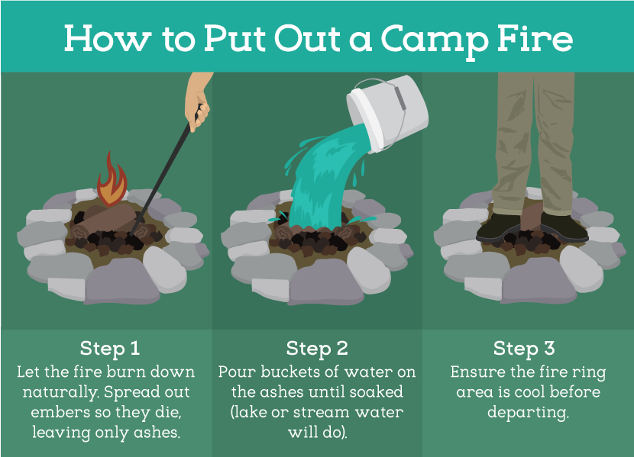

Slide 31
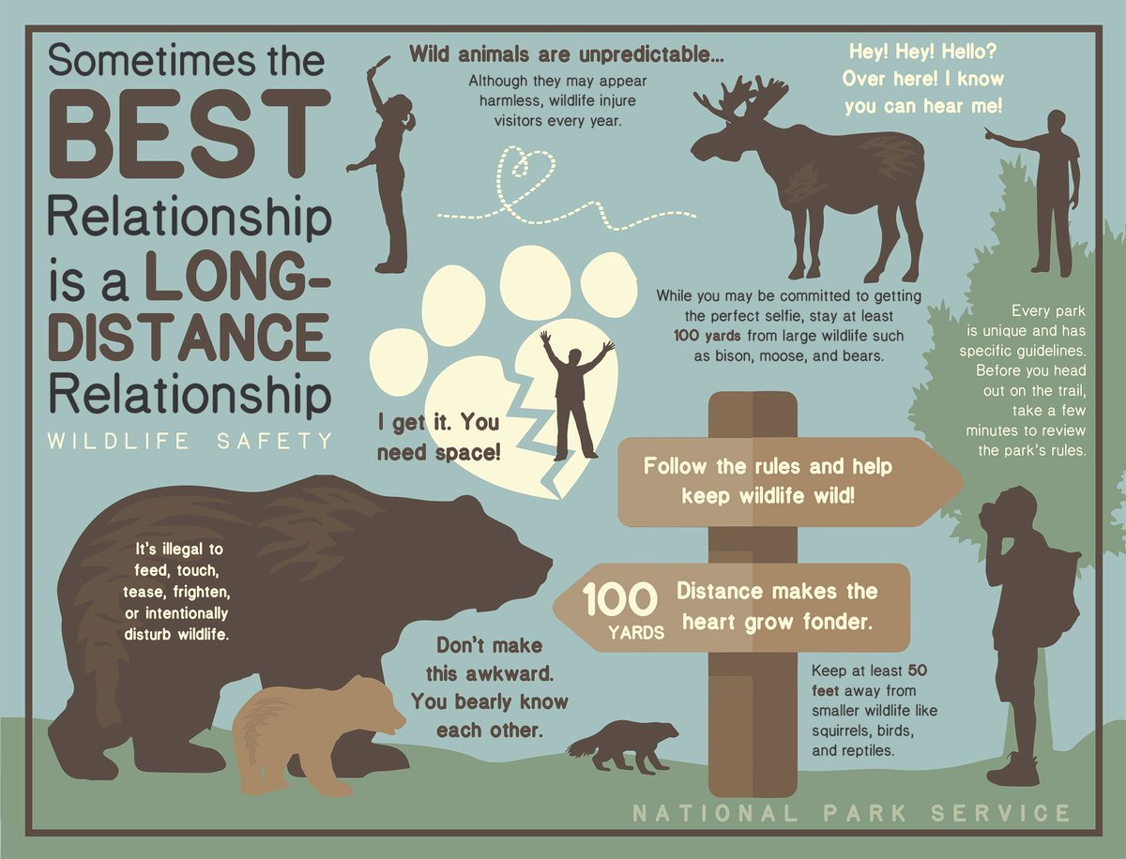
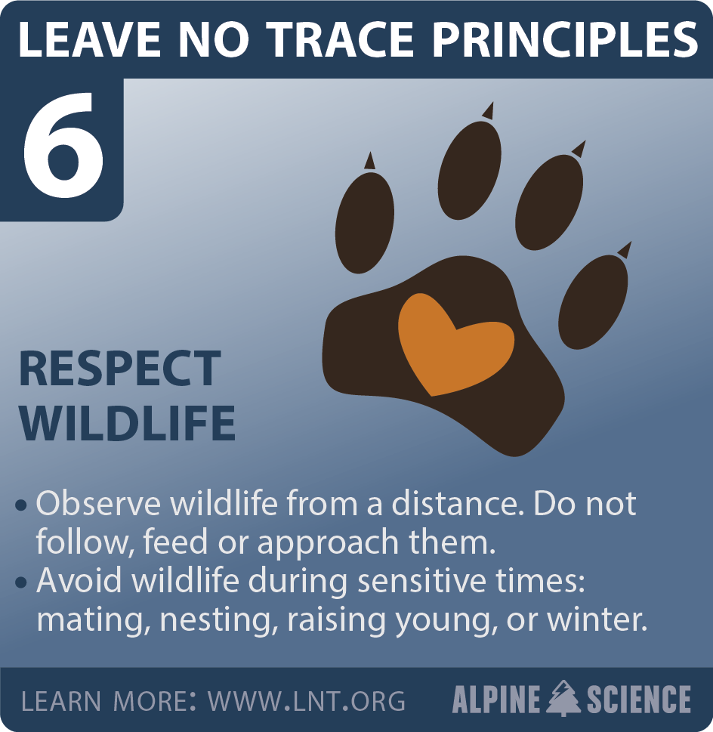

Slide 32
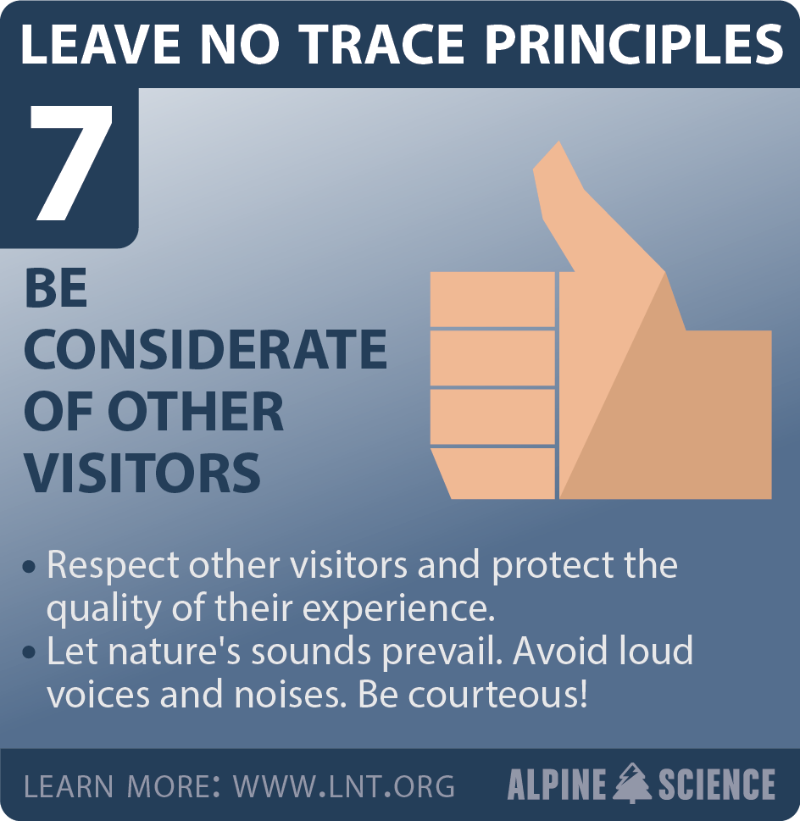
Evaluate your unit

Slide 33
Blooket.com

